Slide 1


Slide 2





CONTENTS
Group Introduction
LECS Introduction
LECS Products & Solution
LPT Introduction
LPT Products & Solution
LEDL Introduction
LEDL Products & Solution
Group Advantages
Customers

Slide 3
Introduction
LECS Group

Slide 4
Group Profile
1981
2 Group
5
Founded
Subsidiaries
Manufacturing Plants
1000+
Position
Employees
Top company in south india

Slide 5
Group Scope
Engg. / Mfg.
Textiles
LECS,LPT, LEDL
Harshni Textiles, Ramlinga Mills
LECS Group
Trading
Dairy
Tourism
Real Estate
Star Line Travels

Slide 6
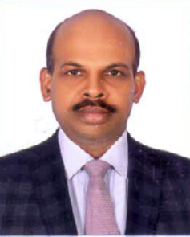
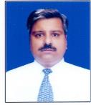
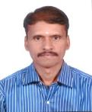
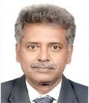
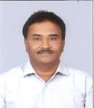
The Strategic Team
Board of Directors
K Jayakumar
Business Head
(LPT)
Palani
(Group Head HR)
R Hariharan
Vice President
(LECS)
Jayapragasan
Head R&D
Thiyagarajan
(CFO)

Slide 7


Vision, Mission & Values
Vision
To be a Premier Multi-Industry Company Known for Manufacturing Excellence through Ethical Business Practices and Quality Standards.
Mission & Values
Create Superior Value For the Stake Holders through Our Products & Services to ensure Sustainable Growth and Operational Excellence using Innovative Methods, Process Driven Approaches and Eco-friendly Solutions.

Slide 8


Industry We Serve
Textile
Machine tools
Utility - T&D
Process Industry
Railway & Metro
Renewable Energy
EV Industry
Petrochemical
Agricultural
Automobile
Telecom
Healthcare

Slide 9
Introduction
LECS

Slide 10
LECS Profile
Plant
1
120+
Customers
Employees
410+
194 Cr
Revenue
Products
77+
152+
Vendors
Founded in 1981
5 Manufacturing Division
BSE listed company
Top company in Panel manufacturing
400+ Employees
Dedicated R&D team

Slide 11

ISO 14001:2004 Certification
2014
2019
SAP ERP ECC 6.0 Implemented
2007
IATF TS 16949:2009 Certification
2013
Collaboration with OSAI-AB, Italy for Manufacture of CNC Systems
5 S Certification by M/s. AOTS Alumni 5S Forum of India
1991
1995
2010
ISO 9001-2008
Up-graded Certification
ISO 9001-1994 Certification
1984
Collaboration with Sprecher + Schuh, for Manufacture of LV Switchgears
Started Control Panel Building & Injection Molding
Milestone
1982
1981
Incorporated

Slide 12
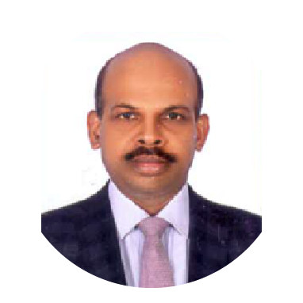
R Hariharan
Vice President
Ravichandran Head Marketing
Baluasubramani
Head Maintenance
Senthilkumar
Head QA
Vajjeravel
Head Operations
  Natarajan
  Head IT
Dhanraj
Project Mgr 3
Jayanth
Head PMS
Kumaresanan
Project Mgr 2
The Operating
Team
Mohan Raj
Head CPD
Mariyappan
Project Mgr 4
V Ponnusamy
Head SCM
Senthilnathan
Project Mgr 1
Subramani Head Head Tool Room

Slide 13

LECS Divisions
Control Panels
Drives & Power Supply
Commercial
Tool Room
Switchgear & Control gear
Engg. Plastic Components
Railways & Metro

Slide 14
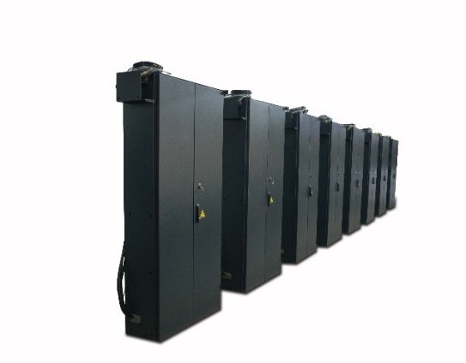
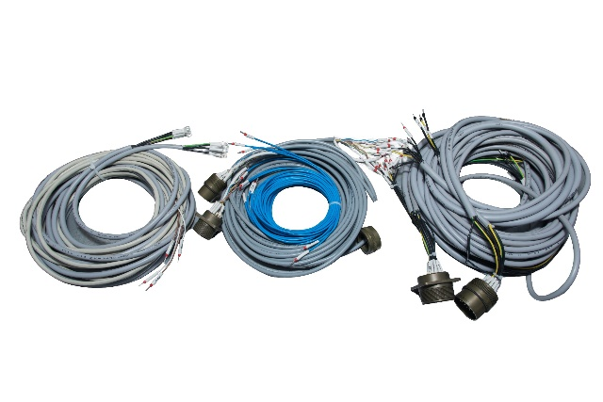
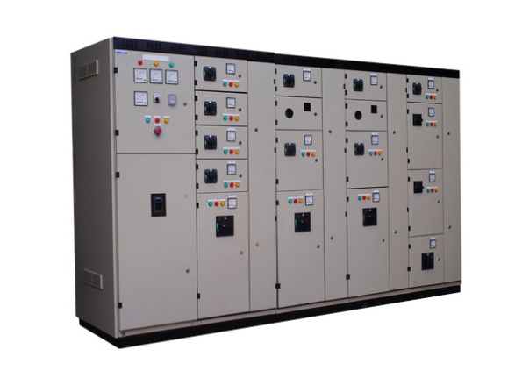
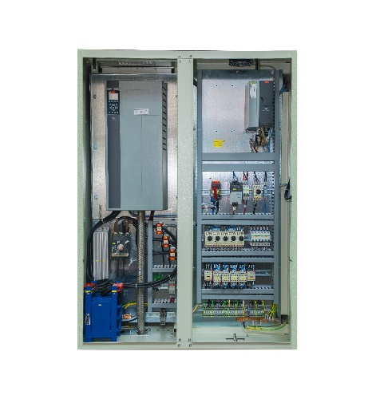
Control Panels
Products
Textile Machinery panels
MCC & PCC – Fixed & Draw out
Drive panels (VFD)
Solar invertor panels
Control & relay panels (CRP)
DCS panels
Automation panels
Contract manufacturing for OEMs
Cable Harness
Machine tools cabinets (MTC)
APFC & Harmonic control panels
Compressor panels
Wind turbine control panels
PLC panels
Solar pump controller
Lighting Distribution Board (LDB)
Panel Enclosure
Machine Control Panel
Cable Harness
PCE/MCE Panel
3000 control panels per month
In house sheet metal fabrication plant
In house cable harness plant
VFD Drive Panel

Slide 15
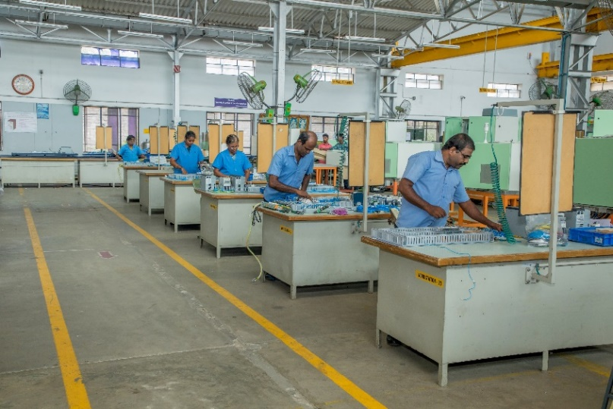
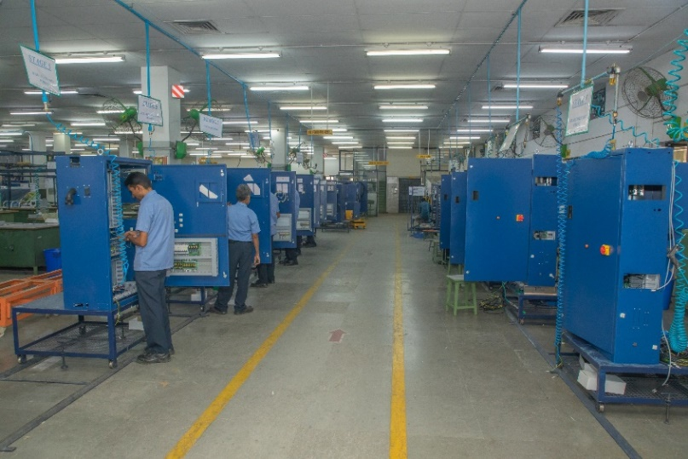
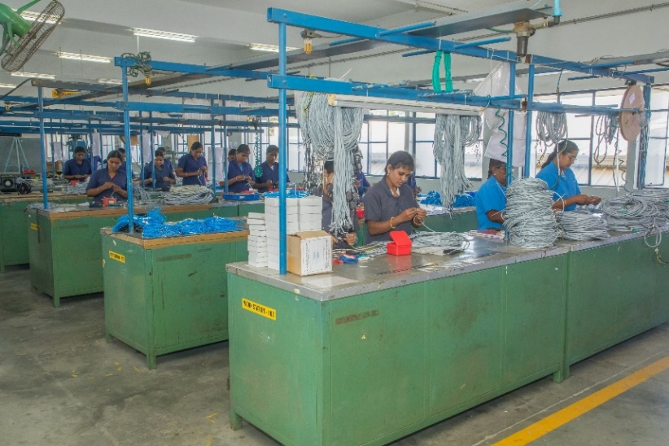
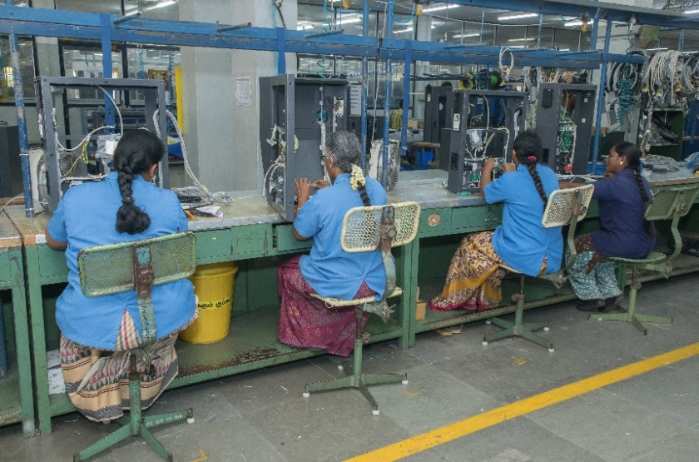
Control Panels Manufacturing Facilities
CPD 1 Assembly Area
CPD 2 Assembly Area
Wire Harness Area
Wiring Area

Slide 16
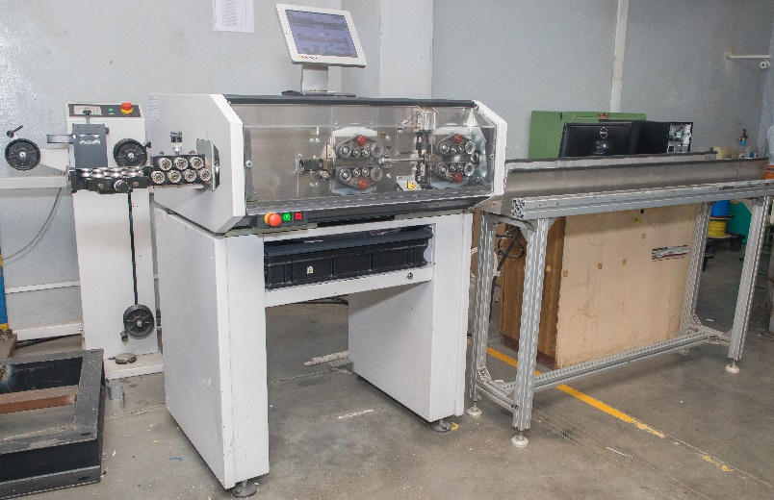
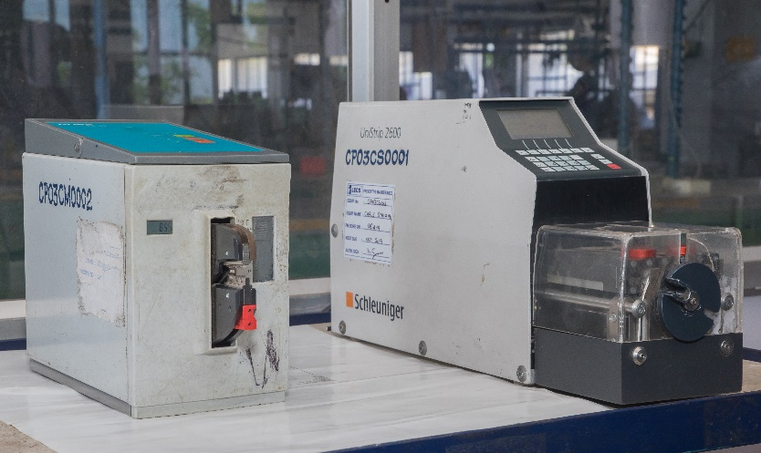
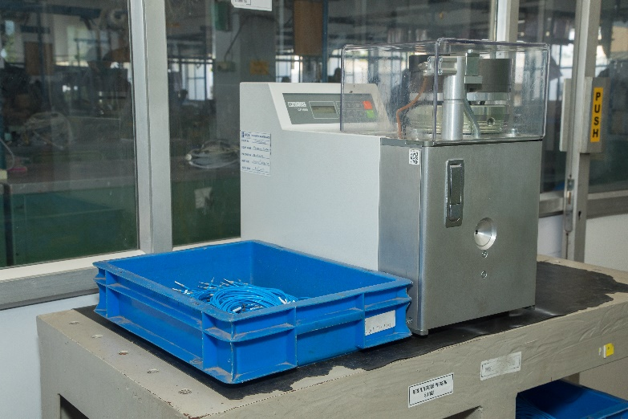
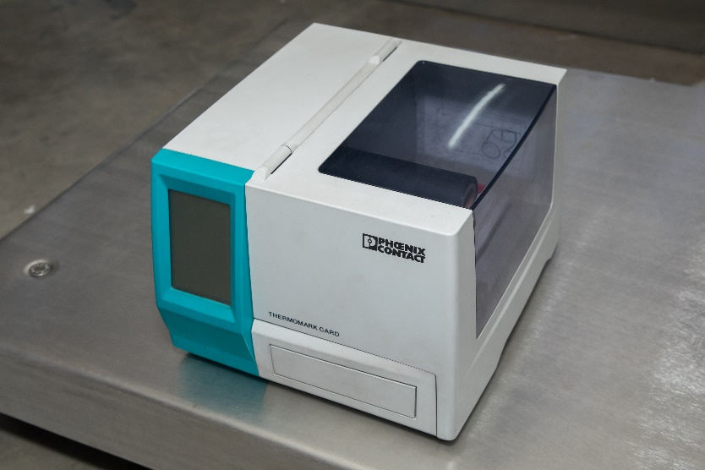
Control Panels Manufacturing Facilities
Automatic Cable Cutting Machine
Semi Automatic Crimping Machine
Automatic Crimping Machine
Multiband Terminal Maker

Slide 17
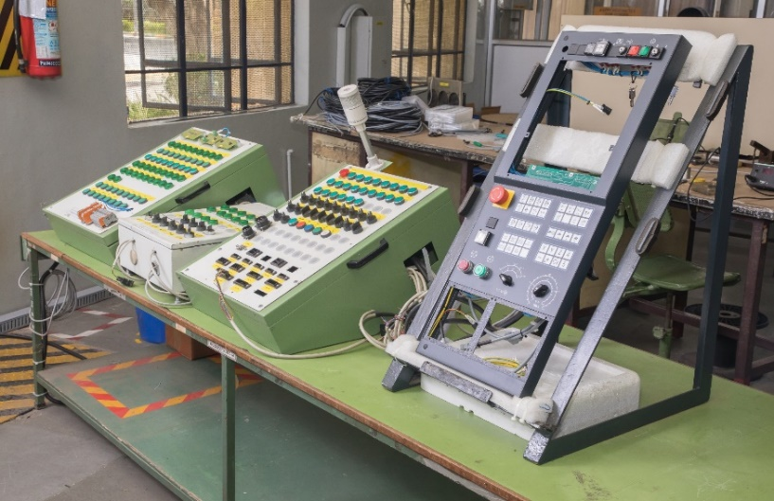
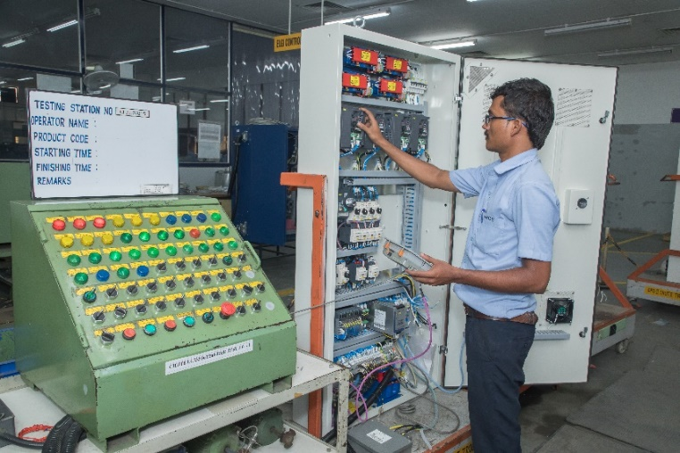
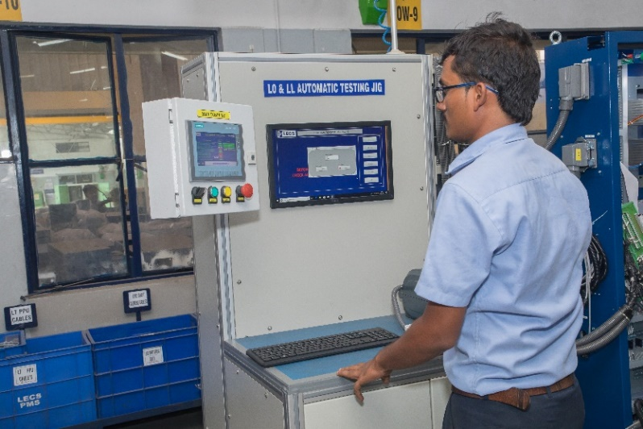
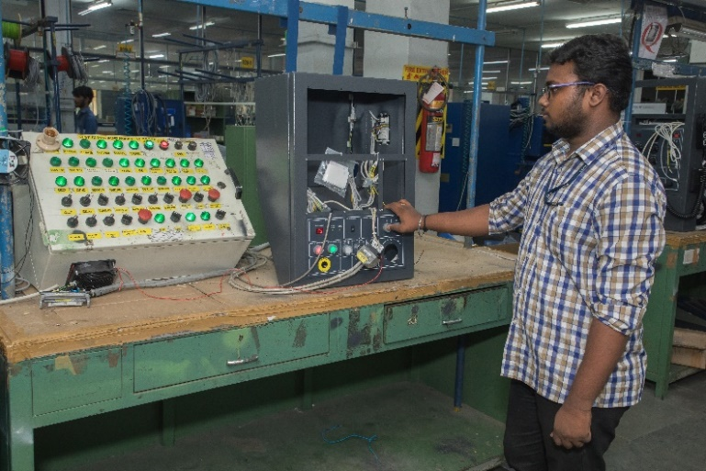
Control Panels Testing Facilities
Cable Harness Testing JIG
Textine Panel Trsting JIG
Automatic Testing JIG
Control Panel Testing JIG

Slide 18
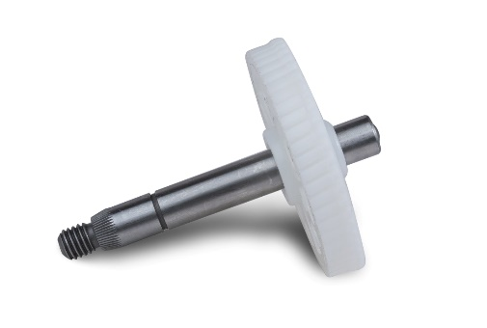
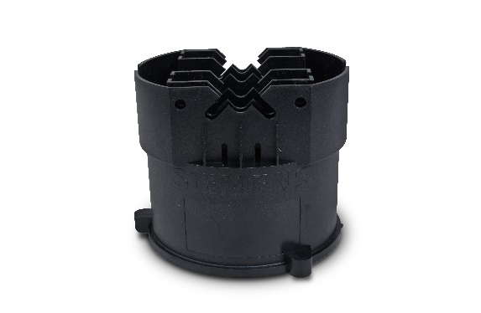
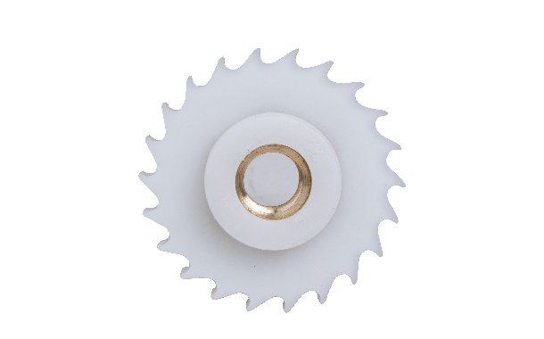
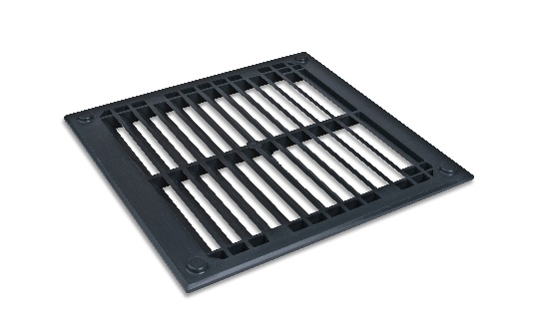
Engg. Plastic Components
Products
Automotive Components
Machinery Parts
Switchgear Parts
Healthcare components
Consumer Electronics
Industrial Application
Components weight ranging from 0.5g to 1000g
Component Size 500mm x 500mm maximum.
Minimum wall thickness 0.5mm
31 world class machines ranging from 45T to 350T
Wide range of raw materials
Automotive Part
Electrical Part
Machine Part
Consumer Electronics

Slide 19
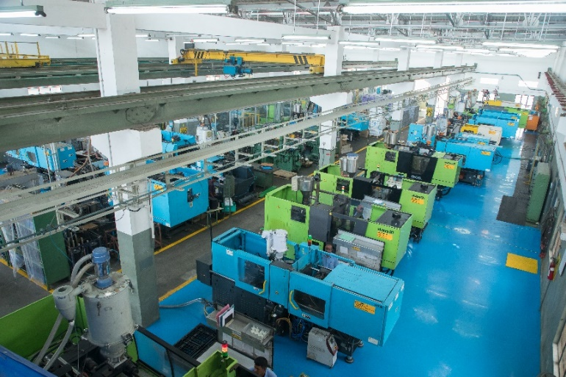
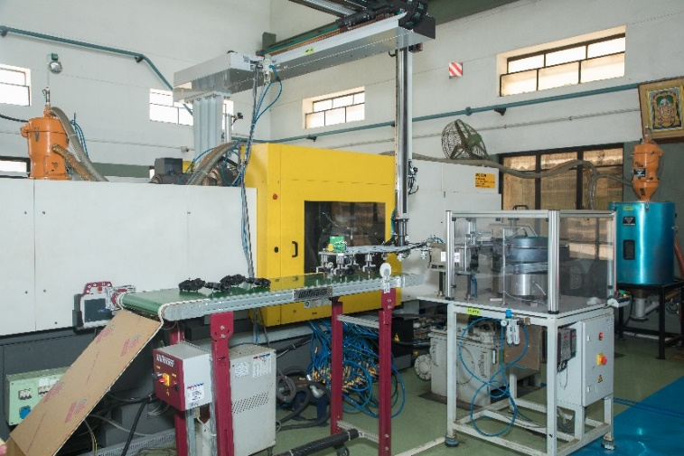
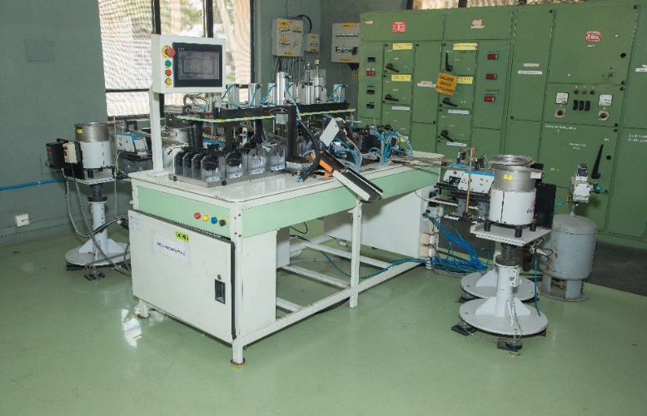
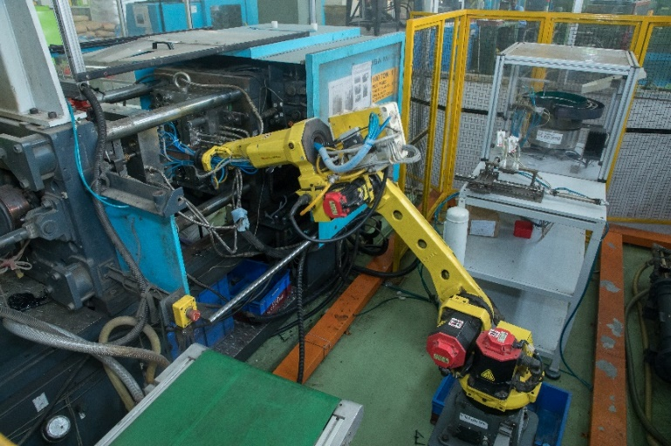
Engg. Plastic Manufacturing Facilities
Plastic Moulding Shop
Automatic Production Line
Automatic Assembly Line
Robo Arm for Insert Moulding

Slide 20
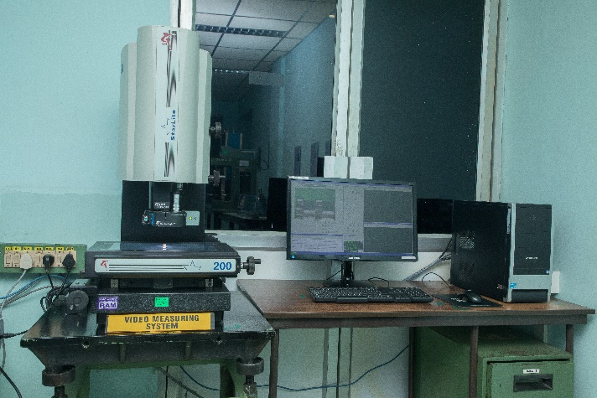
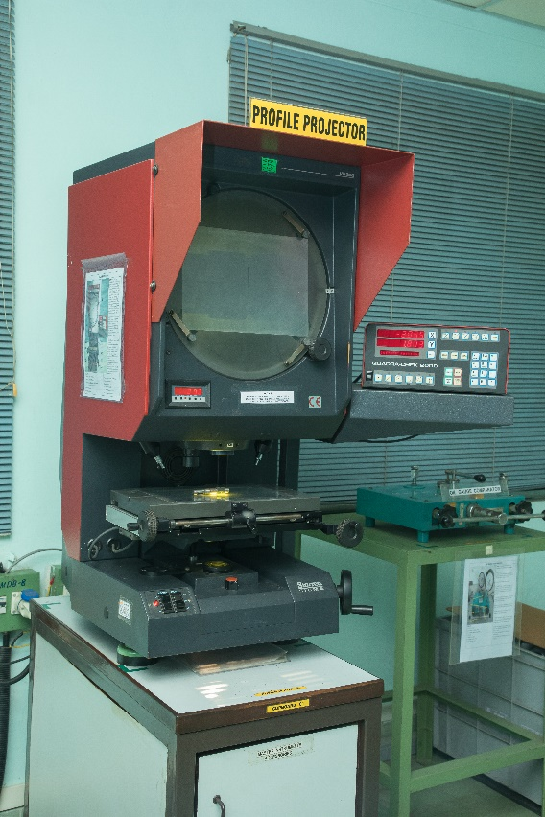
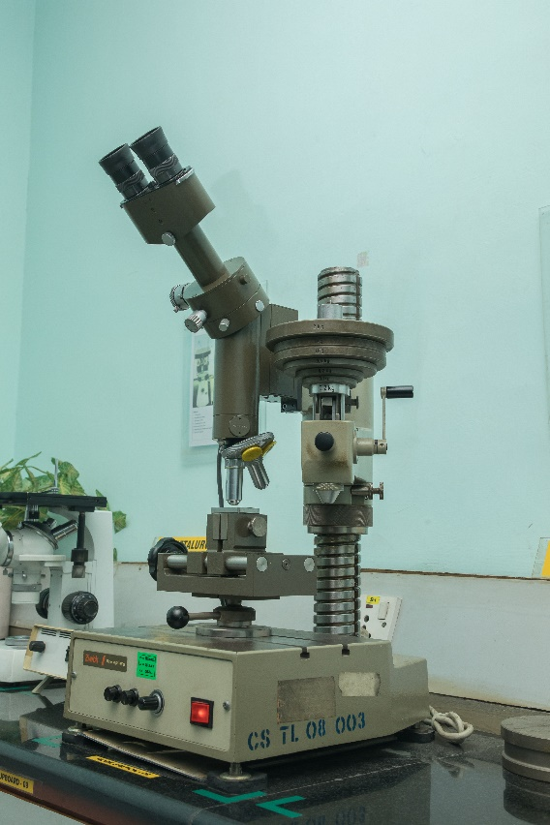
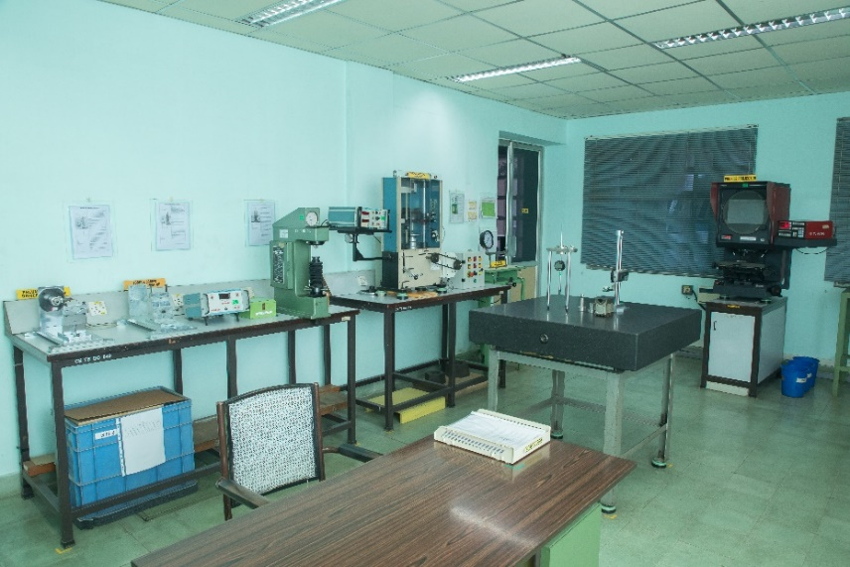
Engg. Plastic Testing Facilities
Video Measuring System
Profile Projector
Microscope
Plastic Lab

Slide 21
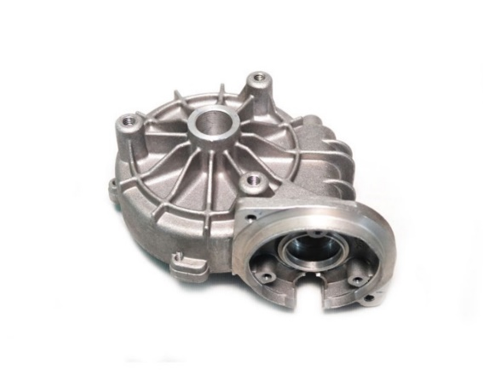
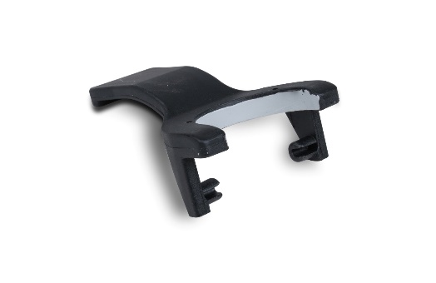
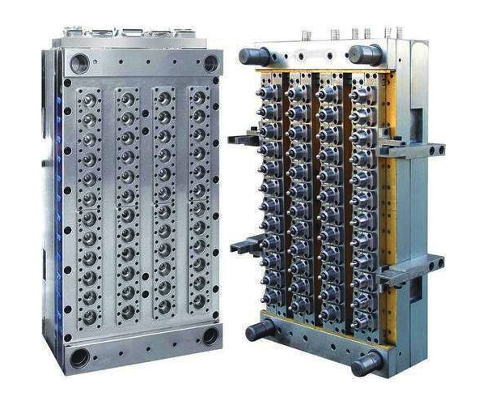
Engg. Plastic Components
Products
Thermoplastic injection moulds
Over moulding
Hot runner moulds
Two and three plate moulds
Connector moulds
Thermo set injection moulds
Insert moulding
High cavitation moulds
Medical moulds
Die casting dies
Die Casting
Insert Moulding
World class machineries
Mould size: up to 1250mm * 850mm.
Mould weight: up to 6MT
Component accuracy: up to 20 microns
Mould life: up to 10Mn shots
Complete In house design
High Cavitation Moulds

Slide 22
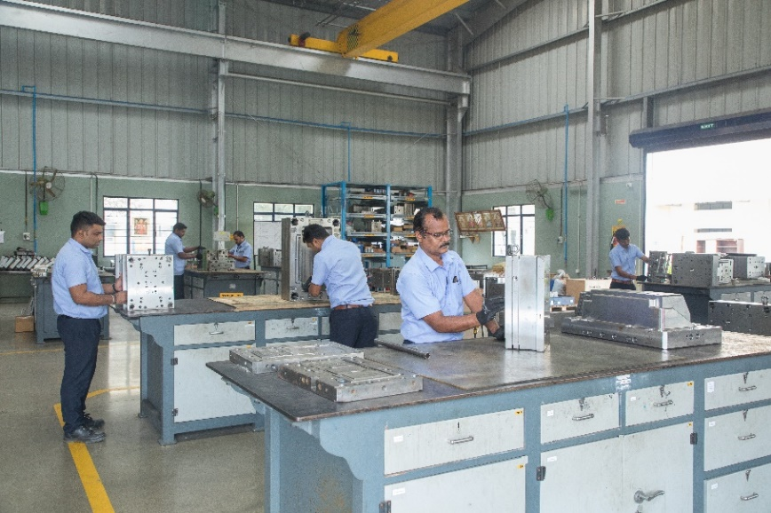
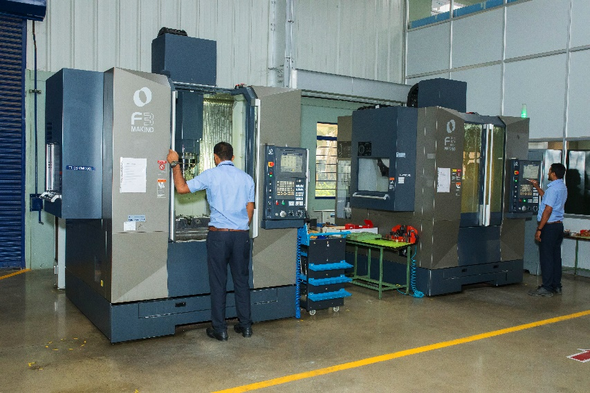
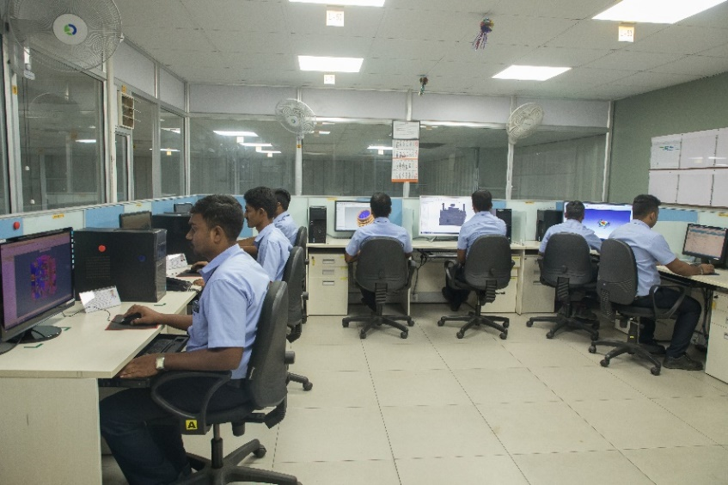
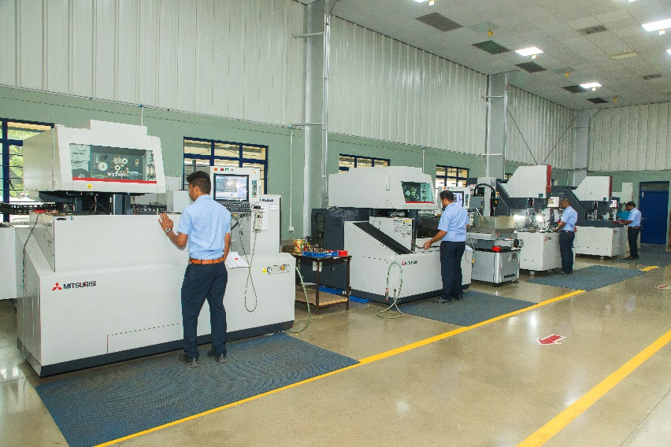
Tool Room Manufacturing Facilities
High speed VMC
Tool Assembly Area
Electric Discharge Machines
Tool Design Centre

Slide 23
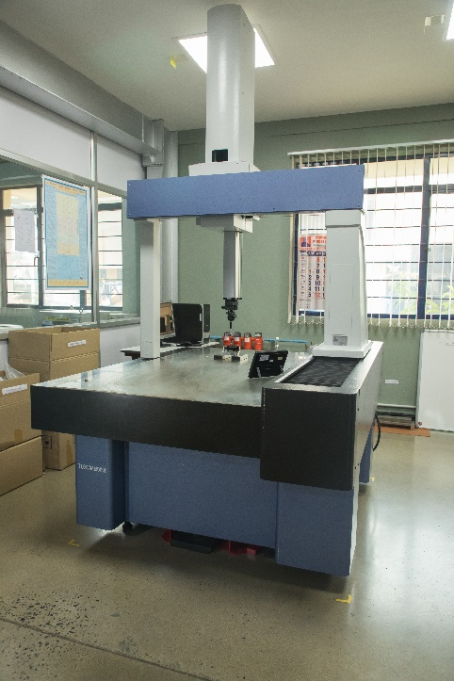
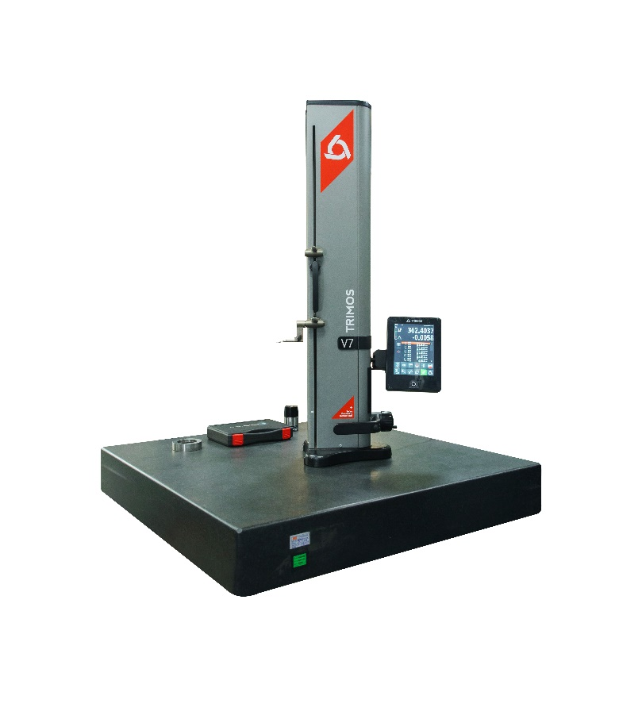
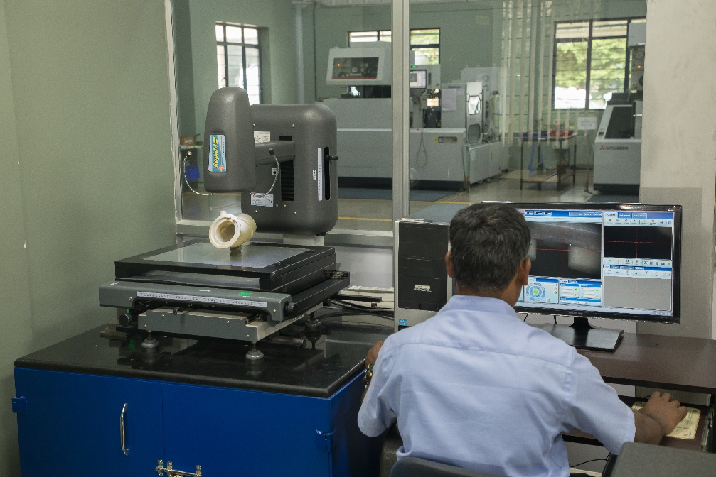
Tool Room Testing Facilities
VMS
Video Measuring System
CMM
Co-ordinate Measuring Machine
Height Master

Slide 24
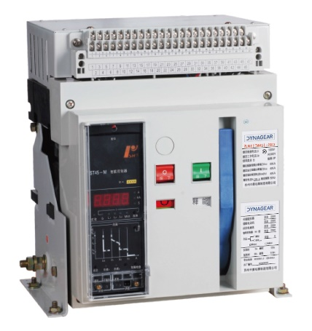
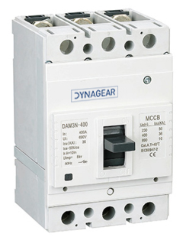
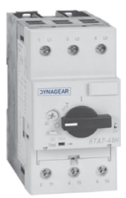
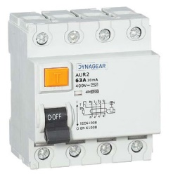
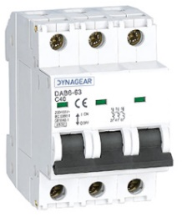
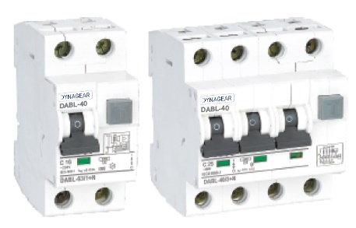





Switchgear & Control gear
Switchgear
Air Circuit Breaker (ACB)
Moulded Case Circuit Breaker (MCCB)
Motor Protection Circuit Breaker (MPCB)
Residual Current Circuit Breaker (RCCB)
RCCB with Over current Protection (RCBO)
Miniature Circuit Breaker (MCB)
Disconnector switch
Load break & CO switch
Automatic Transfer Switch (ATS)
ACB
MCCB
MPCB
RCCB
MCB
RCBO
ATS
Control gear
Power Contactors
Capacitor Duty Contactor
Modular Contactors
Definite Purpose Contactors (DP)
Over Load Relay (OLR)
Capacitor Dum
contactor
Power
contactor
Modular
contactor
OCR

Slide 25





Drives & Power Supply
Products
DG100 Economical AC Drives
(V/F control)
DG620 General Purpose AC Drive
(V/F control, SVC1, SVC2)
DG510 AC Drives (general purpose or textile dedicated)
DG1000 AFE (Active Front End) Drives
DG500 Mini AC Drives (V/F control)
DG820 High Performance AC Drives
(V/F control, SVC1, SVC2, VC control)
DG600E Elevator Dedicated Drives
DGSLR01/02 – Solar Pump Drive
Power Supply Units
Textile Drive
DG 510
Active Front
End Drive
Gen Purpose
Drives
PSU

Slide 26



Railways & Metro
Railways & Metro
Point Machine
Capacitor Panel
Lighting Panel
Battery Box
Wiring Harness
AC & Non AC Panel
Fuse Box
Point Machine
Wiring Harness
RDSO Approval is under progress to supply panels
One of the Panel, Cable Harness & Electro mechanical
arts supplier to
  Integral Coach Factory (ICF)
  Modern Coach Factory (MCF)
  Rail Coach Factory (RCF)
LHB AC/ Non AC Power Panel

Slide 27




What sets us apart?
Customer Centric Approach
High Efficiency and Performance
Customized Solutions
Quality and Reliability

Slide 28

Achievements
Industries
Engineering Capability & Large Project execution
Textiles
1500 Textile panels p.m. since last 30 years.
Renewable
Solar & Wind Panels For OEMs
Machine Tools
600 panels p.m. to
LMW & Makino
OEMs
Type testing and approvals

Slide 29







Product approvals
Reliable crimping
Key Product
Features
Reliable torquing
Customized
Indoor / Out door usability
Hi-Quality Workmanship

Slide 30
LECS Products
Control Panels
Engg. Plastic Components
Switchgear
Textile Machinery panels
MCC & PCC – Fixed & Drawout
Drive panels (VFD)
Solar invertor panels
Control & relay panels (CRP)
DCS panels
Automation panels
Contract manufacturing for OEMs
Cable Harness
Machine tools cabinets (MTC)
APFC & Harmonic control panels
Compressor panels
Wind turbine control panels
PLC panels
Solar pump controller
Lighting Distribution Board (LDB)
Panel Enclosure
Automotive Components
Machinery Parts
Switchgear Parts
Healthcare components
Consumer Electronics
Industrial Application
Air Circuit Breaker (ACB)
Moulded Case Circuit Breaker (MCCB)
Motor Protection Circuit Breaker (MPCB)
Residual Current Circuit Breaker (RCCB)
RCCB with Overcurrent Protection (RCBO)
Miniature Circuit Breaker (MCB)
Disconnectors switch
Load break & CO switch
Automatic Transfer Switch (ATS)
Commercial Tool Room
Thermoplastic injection moulds
Over moulding
Hot runner moulds
Two and three plate moulds
Connector moulds
Thermoset injection moulds
Insert moulding
High cavitation moulds
Medical moulds
Die casting dies
Control gear
Power Contactors
Capacitor Duty Contactor
Modular Contactors
Definite Purpose Contactors (DP)
Over Load Relay (OLR)

Slide 31
LECS Products
Control Panels
Railways & Metro
DG100 Economical AC Drives (V/F control)
DG620 General Purpose AC Drive（V/F control, SVC1, SVC2）
DG510 AC Drives (general purpose or textile dedicated)
DG1000 AFE (Active Front End) Drives
DG500 Mini AC Drives (V/F control)
DG820 High Performance AC Drives（V/F control, SVC1, SVC2, VC control）
DG600E Elevator Dedicated Drives
DGSLR01/02 – Solar Pump Drive
Point Machine
Capacitor Panel
Lighting Panel
Battery Box
Wiring Harness
AC & Non AC Panel
Fuse Box

Slide 32
Introduction
LPT

Slide 33
ISO 14001 & OHSAS 18001 Certification
2015
2018
Business Started with GE worldwide
2004
Launched Textile Machinery Products (DYNADOFF & GLICLEAN)
2014
Collaboration with Sandvik for Mfg. of CNC Tool Holders
5 S Certification by M/s. AOTS Alumni 5S Forum of India
1992
2001
2012
Commenced Pirn Winder (Textile Ancillary Machine) BU
Commenced the operation of Sheet Metal BU
1989
Commenced Jigs & Fixtures BU & Diecasting Division
Commenced SPM Division
Milestone
1987
1983
Incorporated & Commenced the Operation of Cutting Tool Division

Slide 34

The Operating Team
K Jayakumar Business Head
J Rajesh Prabhu
Head Marketing
A Maharaja Head Purchase
S Gurusami Head Operations
M Vijayakumar Head QA
Lalithamani Head Planning
Shripad Desai Head Production 2
R Surendran Head IT
V Ramalingam Head Production 1
Raajkumar
Head Design
Muthukumar
Project Mgr 1
Venkit Kumar Head Plant Maintenance

Slide 35


LPT : Our Capability – Design
LPT delivers a complete comprehensive solution to clients as per their performance requirements and preferred design standards. LPT has delivered equipment as well as heavy fabrication works under design build contract for single orders worth up to $ 4.50 million.
We craft you a custom solution along with erection and installation as per your requirements and preferred standards.

Slide 36


LPT : Our Capability – Design
LPT has successfully developed specialized projects for aerospace and power grid applications, pressure components for process industries and prototype reactors.
Being inclined to design and innovation we have a special consideration for made to order projects and prototypes.
Our clients can choose to partner with us in research and development or just concentrate on their business while we craft them a state-of-the-art solution.

Slide 37


LPT : Our Capability – Design
CFD
Simulation
Kinetics Analysis
Thermal Analysis
Stress Analysis
FEA
Material Analysis
Energy Analysis
Manufacturing Methodology
Problem Solving

Slide 38

LPT : Our Capability – Engineering
We have experience in designing the products meeting the following Mechanical Design Standards
  ASME Sec. I, III, III NB
  ASME Sec. VIII Div. 1-3
  ASME B 31.3API 660
  AD Merkblatter
  AD 2000AS 1210
  IS 2825

Slide 39
LPT : Our Capability – Engineering
HEAVY ENGINEERING Components
CRUSHING MACHINERY PARTS
SPECIAL PURPOSE MACHINERIES
PIPING COMPONENTS
UTILITY PIPING
DAMPERS
FANS
STATIC EQUIPMENT
DUCTING
INDUSTRIAL CHIMNEYS
BATCHING PLANTS
HEAT EXCHANGERS
AIR PRE-HEATERS
MATERIAL HANDLING EQUIPMENT

Slide 40

LPT : Our Capability – Engineering
STEEL STRUCTURES
TOWER STRUCTURES
BASE FRAMES
SUPPORT STRUCTURES
COLUMNS / BEAMS
ELEVATED PLATFORMS
SKIDS
BRIDGES / GIRDERS
STAIR CASES
PIPE RACKS

Slide 41
LPT : Our Capability – Testing
Radiography Enclosure of 100 Curie class (8.5 m x 14.4 m x 6 m).
Inspection and testing facilities like Mass Spectrometer and Boroscope for internal inspection (DIN-7168 EN-1991 & IS2102:1993).
Leak Test under Differential Air Pressure.
Special Technique to check error profile in Gears.
In-house Chemical (ASTM A751) & Mechanical testing laboratory (ASTM-D-2794).
Salt Spray (ASTM-B-117) & Conical Test (ASTM-D-522), Cross Cut Test (IS-101) for Special Processes (ASTM B 1654).
PMI Alloy Analyser.
Qualified Level-II & Level-III personnel available to handle all NDT procedures.

Slide 42






LPT : Achievements
 Installed More than 1000+ MR & DR Scan Tables in US & EUROPE Market
Healthcare
Textile
 Over 100 Million Spindles equipped with LPT Products spinning High Quality Yarn
Renewable Energy
 More than 200+ Inverter panels supplied in the last 2 Years.
Automotive
 Supplying Parts for Automotive occupant Safety for more than 5 years at “0” PPM
Banking
 Successfully installed More than 3500+ ATM Machines in the last 2 Years.

Slide 43







LPT : Key product features
Affordable
Cost
Hi Skilled Workmanship
On time Delivery Every time
Customized Solutions
Competitive Lead-time
Adhering the NDA Principles & Business Ethics

Slide 44







LPT : Our Customization Cycle
Input Gathering & Consolidation
Product Build
Simulation & Analysis
Prototype Build
2D Extraction
3D Modeling

Slide 45




LPT : Facility

Slide 46




LPT : Facility

Slide 47






LPT : Product Portfolio

Slide 48
Introduction
LEDL

Slide 49

The Operating Team
S Sundaramurthy
Head Mfg.
Rajkumar
Head Production
Head Purchase
Suresh Prabhu Head QA
Vijayaraghavan Head Assly

Slide 50
Launch of NEMA and Flameproof Motors
2019
Launch of Roller Table Motors
2015
2018
Launch of Crane Duty
Motors & IE6 Motors
Launch of IE4 Motors
2014
2017
Launch of IE5 Motors
2009
Launch of Special Motors for Renewable Energy Application
Launch of IE3 Motors
Milestone
1998
1983
Incorporated

Slide 51
LEDL : Product Capability
Ultra High Efficiency – IE2, IE3, IE4 and upto IE6
All Enclosures and Cooling Options
Horizontal and Vertical Mounting Options
90W upto 200kW
Fully Customized for Special Applications
230V, 380V, 400V, 415V and others
50Hz, 60Hz, 87Hz and others
IS, IEC, NEMA and CE codes

Slide 52
LEDL : Our Capability
Motors Meeting NEMA Standards
NEMA motors for the North American market Low-voltage motors are manufactured to the NEMA standard for compliance with the local specifications of the NAFTA markets (USA, Canada and Mexico).
This includes motors designed in accordance with the US act, EPACT (specified minimum efficiency levels), as well as motors with NEMA premium efficiency levels. The NEMA motor series provide the highest operating reliability for maximum service life

Slide 53
LEDL : Our Capability
Execution standard: IEC60034-30 and NEMA MG1
Energy efficiency grade: IE, IE4, Upto IE6
Frame size: H80 to H355
Pole: 2P/4P/6P and 8 Pole on Request
Rated power: 0.75kW upto 355kW
Voltage: 380V, 400V, 415V
Frequency: 50Hz, 60Hz
Operation mode: S1 (Other operating cycles available upon request)

Slide 54
LEDL : Our Capability
Enclosed protect class: IP55 (Other enclosures available upon request)
Insulation class: F (temperature rise is examined at 80K)
Cooling method: IC411
Mounting method: B3, B5, B35, V1 (Other mounting options available on request)
Ambient conditions: Altitude is lower than 1000m
Ambient temperature is 15~40deg
Connection: Star-connection for 3KW or less whereas delta-connection for 4KW or more.

Slide 55
LEDL : Achievements
 75kW, 66kW, 90kW developed with IE6.
 Regular production motors in IE4 range. Over 2,000 motors operational in the market.
.
 Unique one off requirement.
 Developed 4.5 kW, 29 V, 3 phase AC motor.
 Specifically developed for Wind energy application.
IE6 & IE4
Pitch Motor
Flame Proof
 Pipeline of complete range of flame proof motors with international certification.
 Motors with circular fins developed upto 30 kW without cooling fans.
 Custom requirement of 250 starts per hour.
 Heavy duty steel rolling
Roller Table
Servo
application.
 Servo motors developed with
wide range of torque ratings.
Radiator Cooling Fan
Multi Speed
 Specialized requirement for Railways.
 Dual Speed motor operating at 127 Hz.
 One off custom requirement.
 Direct drive with 3 speeds in one motor.
 24kW and 30 kW developed with VFD.
 Developed for and approved by Liebherr Germany for tower crane application.
 Special external rotor.
 Currently under RDSO validation.

Slide 56







LEDL : Key product features
Low power consumption
High power factor
High Power to Weight ratio
Customized
Low heat generation
Low vibration

Slide 57




LEDL : Facility
Fully certified and flexible production capability
Motor test bench
Winding impregnation with UV curing
Dynamically balanced rotors for silent performance

Slide 58

























Few of our Esteemed Client

Slide 59

Contact Us
Hariharan R, Vice President
hariharan.r@lecsindia.com
+91 422 3093555
+91 73958 02270
Arasur, Coimbatore 641407
Jayakumar K, Business Head
jayakumar.k@lptindia.com
+91 422 7173500
+91 98423 58926
Arasur, Coimbatore 641407
Sowjanya Varadhan S, GM
sowjanya@ledl.in +91 422 6631101
+91 99406 85223
504,Avinashi Road, Peelamedu,
Coimbatore - 641004

Slide 60
THANK YOU !

